Slide 1
AIC EGERTON CHAPEL
SUNDAY
17.11. 2024

Slide 2
EZEKIEL 1:10 ; REVELATION 4:7

Slide 3
When we confess Jesus Christ as Lord (Kurios)
We AFFIRM OUR ALLEGIANCE to Christ alone
We BOW to Christ’s Authority
We COMMIT all we are, all we have, and all we hope to be to Him Alone
We DETHRONE our own ways and wil

Slide 4
HIS NAME IS
WONDERFUL: Four Titles—Same Savior

Slide 5
INTRODUCTION
Why are there Four Gospels? Why not just one?
Why did the Lord lead four Evangelists from varied backgrounds to sit down and write of the Lord Jesus Christ?
So that we might have Four Wonderful Perspectives of the Savior.

Slide 6
Who were these Evangelists
Matthew – Tax Collector - Jew
Mark – Peter’s Companion
Luke – Medical Doctor
John – Beloved Disciple of Jesus

Slide 7
Ezekiel 1:10 & Revelation 4:7
The Four-faced Creature of was the fourfold portrait of the Lord Jesus Christ
Four faces of a Lion, an Ox, a Man, and an Eagle.

Slide 8

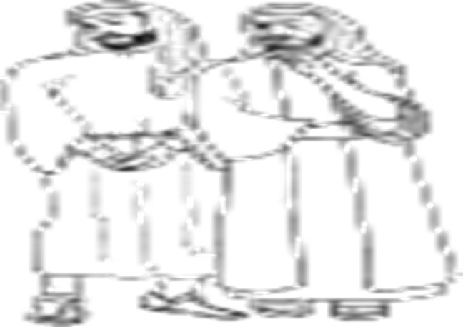


Cont’d
MATTHEW -LIONLIKE – JEWS -the Great King
LUKE - MANLIKE – GREEKS - “The Son of Man
JOHN - EAGLELIKE – WORLD The Word made flesh,
MARK - OXLIKE – ROMANS
Faithful SERVANT

Slide 9
All Evangelists recognized Him to be ELOHIM – All Powerful – Miracles; Sinless life; Defeated Sin & Death

Slide 10
Cont’d
In Matthew, Christ is the Son of David, the Son of Abraham. But in all Four Gospels He is King, Servant, the Perfect Man, and the Eternal God

Slide 11
Matthew’s Gospel – 21:5
Jesus is a Jew – Long Awaited Messiah – Fulfilment of O.T Prophecies
Family Tree 1:1, 6 – Gen. 12; 2Sam 7:8-16

Slide 12
Mark 10:45
Faithful Servant – Different from the Gentile rulers who Lord
Not just high & exalted but has come among us to Serve

Slide 13
Luke 19:10 – Perfect Man
Genealogy – 3:38 – Adam
Daniel 7:13- 14 – Son of Man
Human Interest

Slide 14
John – The Divine Son of God 20:30-31
Matt. Mark Luke – Earthly Perspective - Humanity
John – Heavenly Perspective – Divinity – 1:1-14 - Yahweh – IAM – Exod. 3:14
Believe and have life

Slide 15
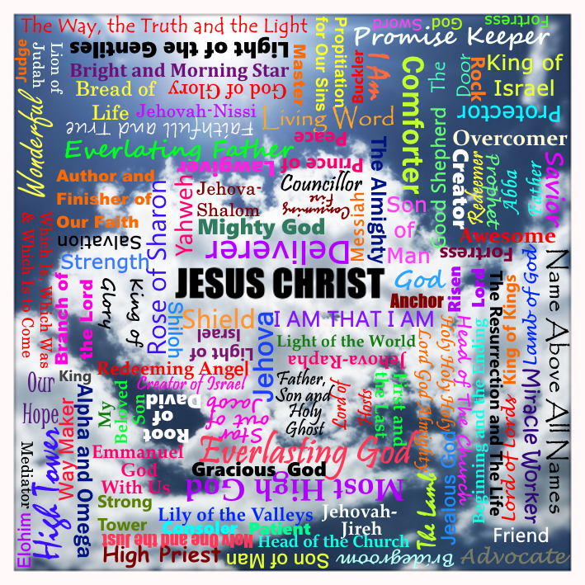
Names of Jesus

Slide 16
Conclusion
Four Titles – Same Saviour
Teaches us that:
We ALL Have Role to Fill
God wants to use each of our roles to cause others to believe – Consistency, service, compassion, Believe

